Slide 1
TNGS Learning Solutions AWS Solutions Architect Online Course UNDERSTANDING VIRTUALIZATION

Slide 2
What IS Hypervisor?
Hypervisor is a software layer that sits between Hardware and OS which will interact with hardware and resources and provide an interface to share the available resources to virtual containers.

Slide 3
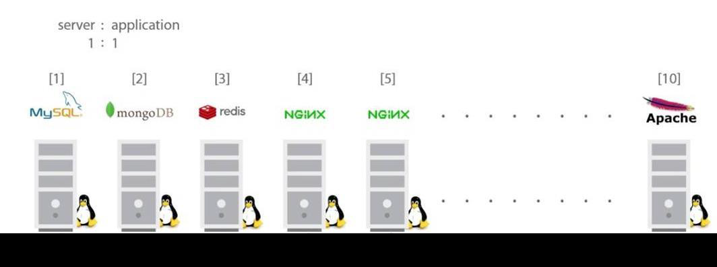
Problem: Installing multiple software on same machine can result to complications.
VIRTUALIZATION

Slide 4
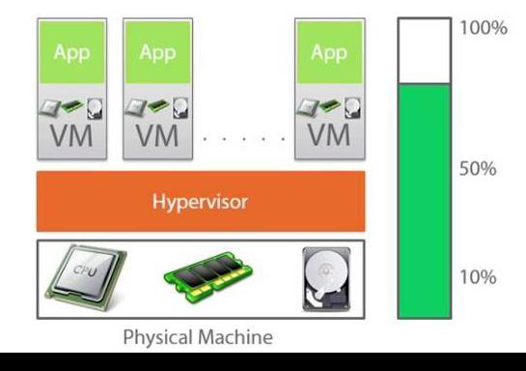

Slide 5
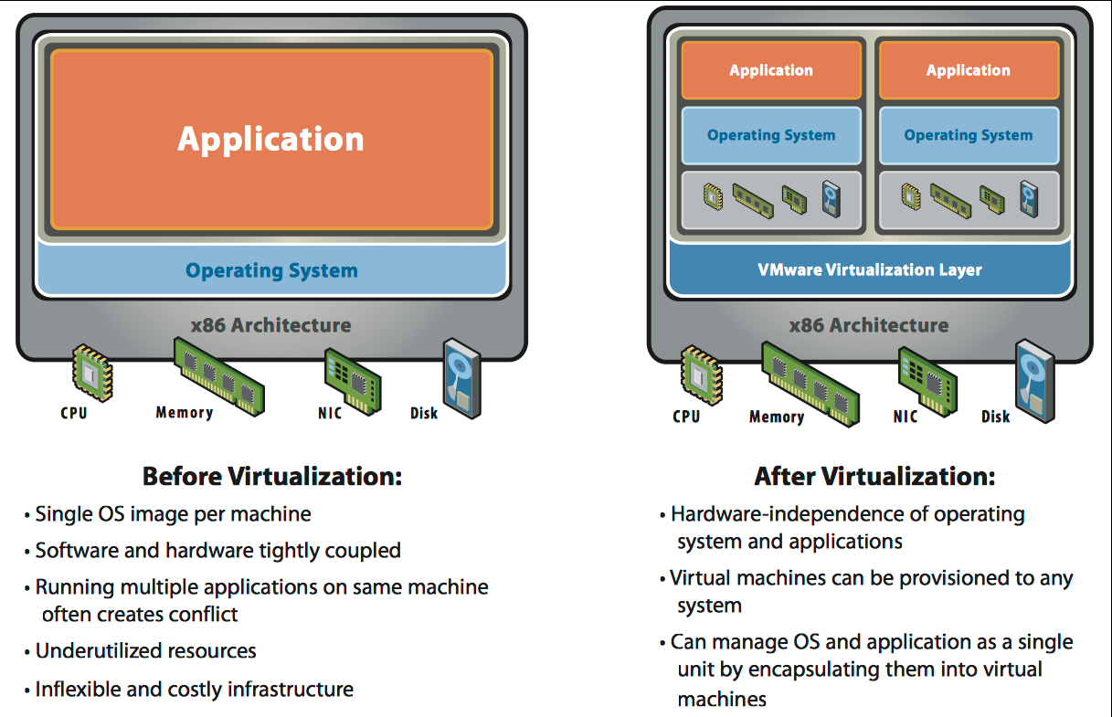

Slide 6
Virtualization Vs Cloud Computing
Virtualization is a technology where Cloud Computing is a service.
Without virtualization, there is no Cloud Computing.
Cloud Computing is built on top of Virtualization.

Slide 7
Benefits of Virtualization
Resource Utilization: Virtualization optimizes the utilization of physical hardware resources, such as CPU, memory, and storage, by running multiple virtual instances on a single server. This reduces hardware underutilization and saves costs.

Slide 8
Benefits of Virtualization
Isolation: Virtualization provides strong isolation between virtual instances. A failure or issue in one virtual machine does not affect others, enhancing system stability and security.

Slide 9
Benefits of Virtualization
Flexibility and Scalability: Virtualized environments are highly flexible and scalable. Virtual machines can be provisioned or de-provisioned quickly to adapt to changing workloads.

Slide 10
Benefits of Virtualization
Cost Savings: By consolidating multiple virtual instances onto fewer physical servers, organizations can reduce hardware acquisition and maintenance costs, as well as energy consumption.

Slide 11
Benefits of Virtualization
Disaster Recovery: Virtualization simplifies disaster recovery planning and implementation. Virtual machines can be easily replicated, backed up, and restored in the event of a hardware failure or disaster.

Slide 12
Benefits of Virtualization
Resource Management: Virtualization allows for granular resource allocation and management. Resources can be allocated dynamically based on demand, ensuring efficient use of computing power.

Slide 13
Benefits of Virtualization
Development and Testing: Virtualization is valuable for software development and testing, as developers can create and test applications in isolated virtual environments without affecting production systems.

Slide 14
Benefits of Virtualization
Legacy System Integration: Virtualization enables the hosting of legacy applications on modern hardware, extending the lifespan of legacy systems.

Slide 15

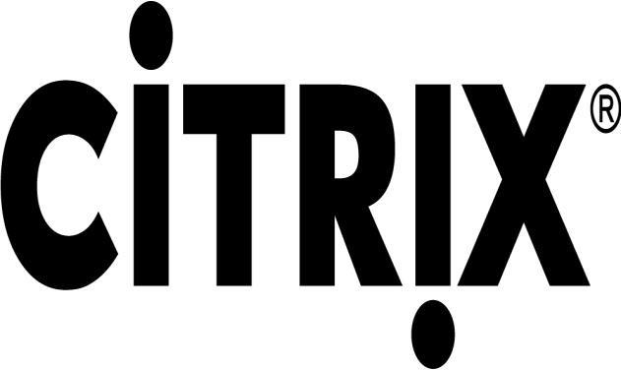
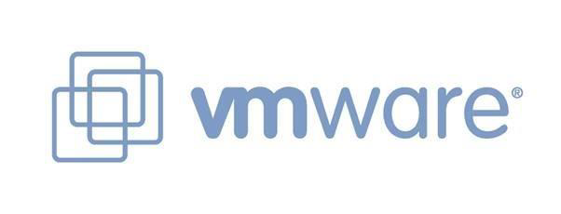
Vendors

Slide 16
Conclusion
Virtualization is an essential and foundational technology for cloud computing, enabling cloud providers to create and manage virtualized infrastructure for their customers.
These platforms facilitate the creation, management, and migration of virtual machines in data centers and cloud environments.

